Slide 1
Healthy Lifestyle
Do you want to be healthy?
Project work
Kovtun S.
Shevchenko A.
Primak T.
Salo N.

Slide 2
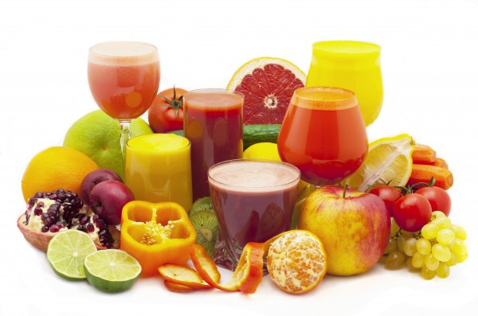
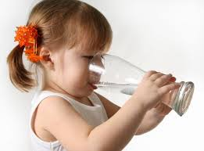
Healthy Lifestyle
To drink juice

Slide 3
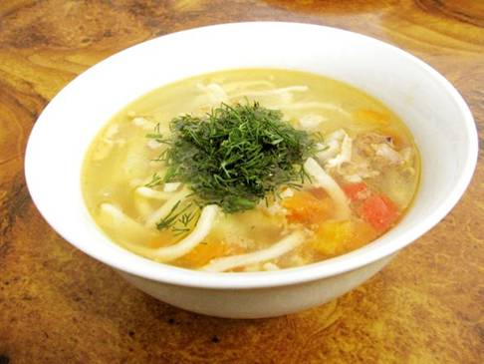
Healthy Lifestyle
To eat healthy breakfast

Slide 4
Healthy Lifestyle
To eat fresh fruits

Slide 5
Healthy Lifestyle
To eat fresh vegetables

Slide 6
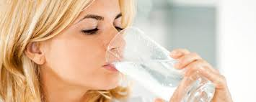
Healthy Lifestyle
To drink clean water

Slide 7
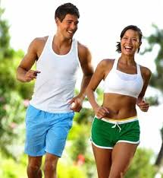
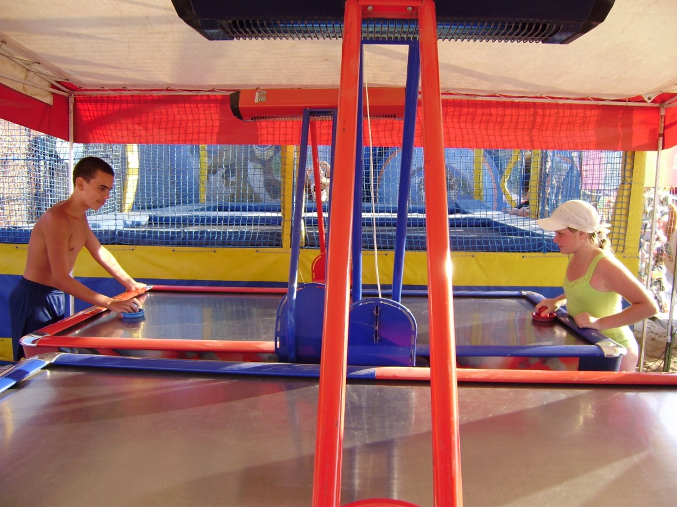
Healthy Lifestyle
To go in for sports

Slide 8
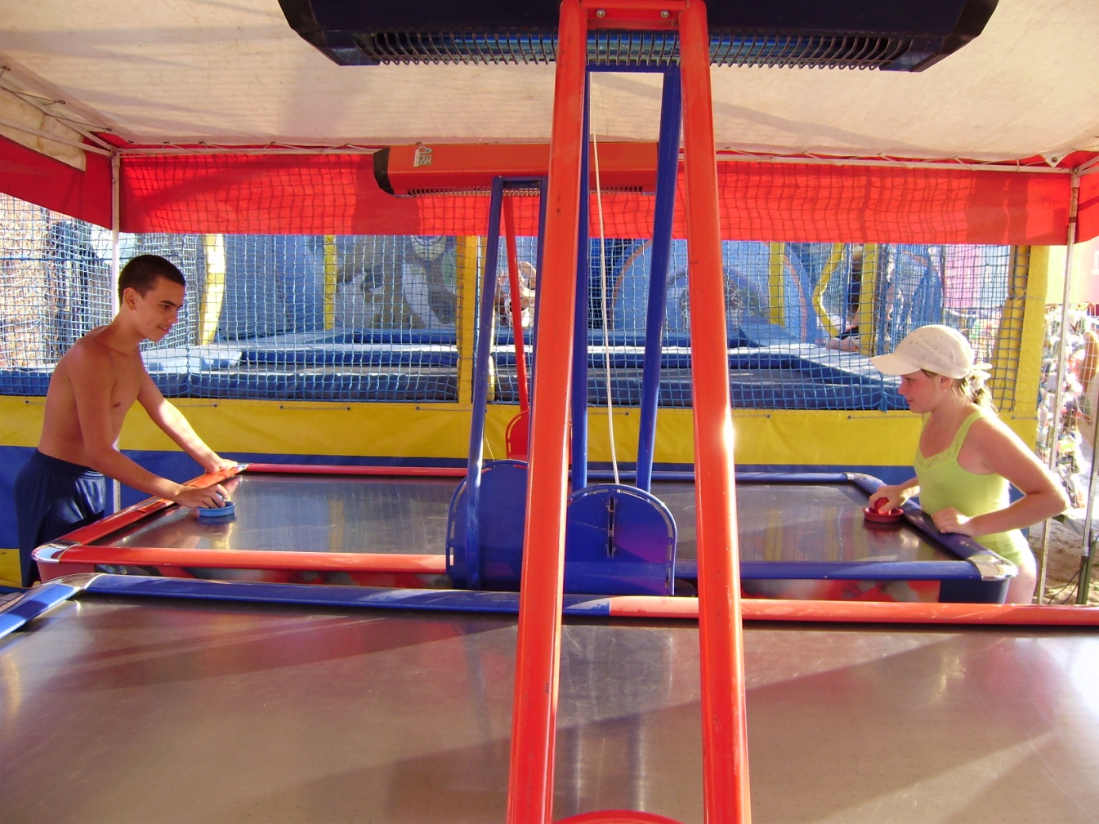
Healthy Lifestyle
To play table tennis

Slide 9
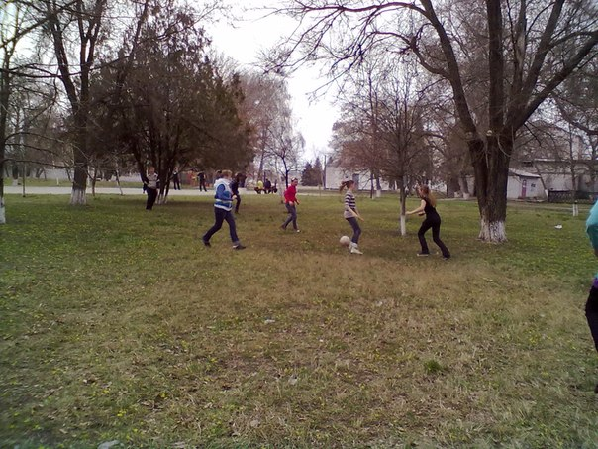
Healthy Lifestyle
To play football

Slide 10
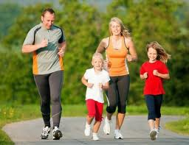
Healthy Lifestyle
To walk outside

Slide 11
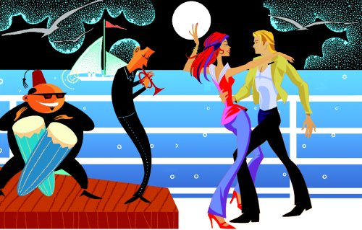
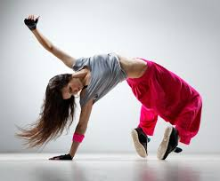
Healthy Lifestyle
To dance

Slide 12
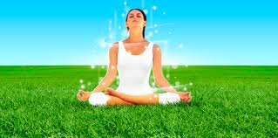
Good luck you!

